Slide 1

Project Presentation
(For Topic Finalization)
An Autonomous AI Agent Capable of Creating, Testing and Integrating Its Own Tools
Group ID:05
Group Members:
Apurva Patil
Toshal Zambare
Sarthak Nalawade

Slide 2
Abstract
Most existing AI agents depend on predefined tools, limiting their autonomy and scalability. When encountering unsupported APIs or services, manual developer intervention is typically required. This project proposes a Self-Forging AI Agent capable of dynamically creating, testing, repairing, and integrating its own tools at runtime with minimal human effort.The framework leverages a coding-capable Large Language Model (LLM) as its central intelligence. When a new capability is needed, the agent generates the tool, executes and validates it within a secure Docker sandbox, automatically repairs errors, and registers the verified capability using the Model Context Protocol (MCP). This newly created tool is then stored for future tasks, allowing the agent to progressively expand its capabilities.This approach significantly reduces manual development overhead while dramatically enhancing the adaptability, scalability, and autonomy of AI agents in dynamic software environments.
Keywords: Self-Forging AI Agent • Large Language Model (LLM) • Docker Sandbox • Model Context Protocol (MCP) • Autonomy • Dynamic Tool Creation

Slide 3
Introduction
Modern AI agents powered by Large Language Models (LLMs) can reason about complex user requests and interact with external systems through APIs, databases, and software services. However, traditional agents typically operate within a predefined collection of tools created by developers. When a required capability is missing, these systems inevitably fail to complete tasks without manual human development and integration. To overcome this limitation, the proposed Self-Forging AI Agent framework extends the conventional paradigm by dynamically constructing new tools on demand according to real-time task requirements. Instead of merely selecting from an existing static library, this autonomous system dynamically identifies missing capabilities, designs the necessary interface, generates executable Python code, validates it within a secure, isolated Docker sandbox, automatically repairs any runtime errors, and registers verified implementations. This continuous closed-loop cycle of reasoning, tool creation, validation, execution, and persistent reuse eliminates manual development overhead, dramatically enhances scalability, and moves AI agents toward truly adaptive and self-expanding intelligent systems.

Slide 4
Problem Statement
Current AI agent systems largely depend on fixed and predefined tool libraries to interact with APIs, databases, and external services. When an unsupported system or new capability is encountered, developers must manually design and integrate the required tools, increasing development effort and limiting agent adaptability. Although LLMs can dynamically generate code, such code may contain syntax, logical, interface, or runtime errors, making one-shot tool generation unreliable. Furthermore, dynamically generated tools must be safely tested and validated before execution, while many existing approaches create temporary task-specific scripts rather than persistent and reusable capabilities.
Therefore, there is a need for a self-forging AI agent that can autonomously identify missing capabilities, generate the required tools, securely test and repair them, and permanently integrate validated tools for reuse in future tasks with minimal human intervention.

Slide 5
Objectives
To identify whether the current tool library can satisfy a user's request.
To detect missing capabilities automatically.
To use an LLM to determine the functionality required from a new tool.
To dynamically generate executable Python tools.
To automatically construct appropriate tool interfaces and schemas.
To execute generated tools inside an isolated Docker sandbox.
To automatically detect syntax, runtime, and functional errors.
To implement a self-repair feedback loop for failed tools.
To validate generated tools using automated test cases.
To register successfully validated tools using MCP.
To maintain a persistent Tool Registry for future reuse.
To enable the agent's capabilities to expand progressively over time.

Slide 6
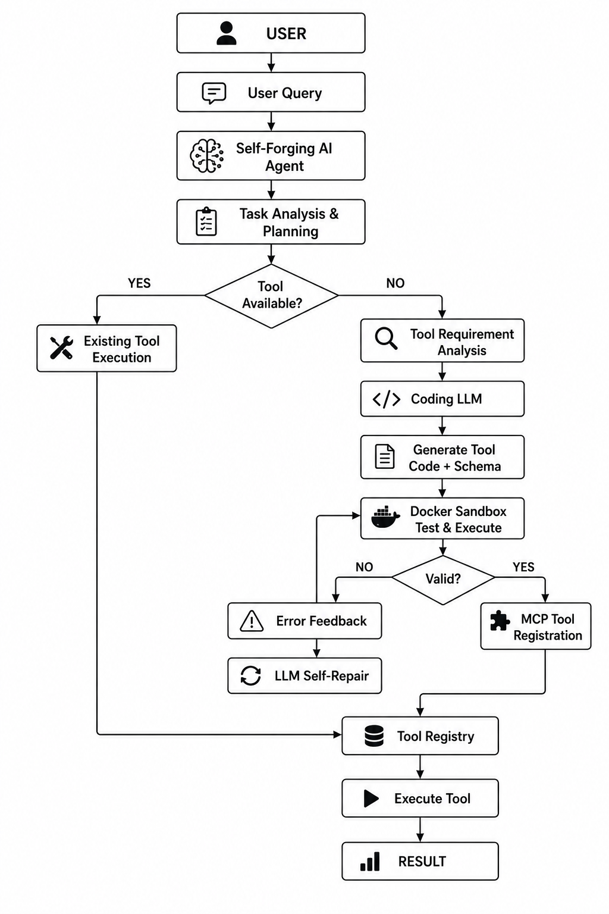
System Architecture

Slide 7
Requirements
Hardware | Software
Laptop/Desktop | Python
Ram 16GB | LangChain / LangGraph
Multi-core CPU | LLM APIs or Open-Source LLMs
GPU | SQLite / PostgreSQL , Git & GitHub

Slide 8
Expected Outcome
An AI agent capable of recognizing when a required tool is unavailable.
Automatic generation of new tool interfaces and executable code.
Secure testing of dynamically generated tools.
Automated detection and repair of tool failures.
MCP-based registration of validated tools.
Persistent storage and reuse of previously created capabilities.
Reduced dependence on manually developed integrations.
Improved adaptability to new APIs, databases, and software environments.
Creation of a continuously expanding tool ecosystem.
A practical prototype demonstrating self-expanding AI capabilities.

Slide 9
References:
[1] B. Xia et al., "Tool-Genesis: A Task-Driven Tool Creation Benchmark for Self-Evolving Language Agent," arXiv:2603.05578, 2026.
This paper introduces Tool-Genesis, a benchmark for evaluating language agents that can autonomously create, improve, and reuse software tools.
[2] T. Cai et al., "Large Language Models as Tool Makers," 2023.
The authors demonstrate that Large Language Models can generate executable software tools directly from natural language instructions.
[3] T. Schick et al., "Toolformer: Language Models Can Teach Themselves to Use Tools," 2023.
Toolformer enables language models to learn how to use external tools through self-supervised learning without requiring manual annotations.
[4] Y. Qin et al., "ToolLLM: Facilitating Large Language Models to Master 16000+ Real-World APIs," 2023.
ToolLLM provides a framework that allows language models to interact with more than 16,000 real-world APIs using intelligent retrieval.
[5] S. Yao et al., "ReAct: Synergizing Reasoning and Acting in Language Models," 2023.
ReAct combines logical reasoning with action execution, enabling language models to think before interacting with external tools or environments.

